Slide 1
Project (BCC605)
Sample Project - Laravel 6
BCAS CITY CAMPUS

Slide 2
In this session, we will cover…
Creating a Laravel Project
The Laravel Basics
Routing, Views, Controller, Requests, Responses
CSRF Protection, Validation.
Logging.
Blade Templates.
Database
Database Connection.
Migrations and Seeding.
CRUD, Query Builder.
Security
Authentication.
Email Verification.
Encryption, Hashing.
Resetting Passwords
2

Slide 3
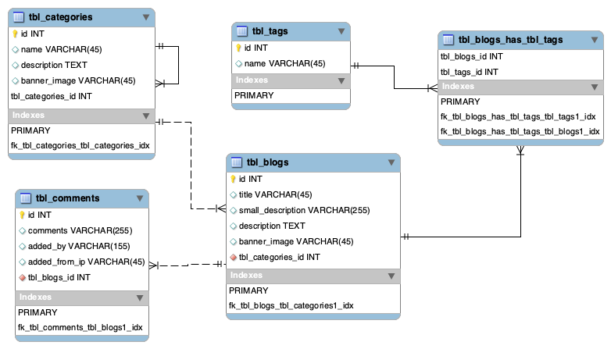
The Database Structure
The Blogs Database
2

Slide 4
Creating a Laravel Project
Create a new project via composer
Open the terminal or command prompt and navigate to the web folder.
cd /Users/iyngaran/kb/php
To create a new project, run the following command from the command prompt.
composer create-project --prefer-dist laravel/laravel topup-blogs
Go to the project folder.
cd topup-blogs
Serve your application using PHP's built-in development server
php artisan serve
Refer the Laravel installation documentation for more details - https://laravel.com/docs/6.x/installation
https://www.youtube.com/watch?v=eD4yMI-IR8g&t=161s
2

Slide 5
Creating a Laravel Project
Create a new project via composer
Open the terminal or command prompt and navigate to the web folder.
cd /Users/iyngaran/kb/php
To create a new project, run the following command from the command prompt.
composer create-project --prefer-dist laravel/laravel topup-blogs
Go to the project folder.
cd topup-blogs
Serve your application using PHP's built-in development server
php artisan serve
Refer the Laravel installation documentation for more details - https://laravel.com/docs/6.x/installation
https://www.youtube.com/watch?v=eD4yMI-IR8g&t=161s
2

Slide 6
Routing
Routing in Laravel allows you to route all your application requests to its appropriate controller.
The routes/web.php file defines routes that are for your web interface. These routes are assigned the web middleware group, which provides features like session state and CSRF protection.
Named routes.
Named routes allow the convenient generation of URLs or redirects for specific routes.
Refer the Laravel documentation for more details - https://laravel.com/docs/6.x/routing
https://www.youtube.com/watch?v=Bzd-rI52G-k&t=30s
2

Slide 7
Routing
Adding routes for the pages.
Web Route - routes/web.php
// home page
Route::get('/', function () {
echo "Welcome to home page";
})->name('frontend.home');
// blog page
Route::get('/blog', function () {
echo "Welcome to blog list page";
})->name('frontend.blog');
…………..
Here is the complete code - https://github.com/iyngaranedu/topup-blogs/blob/01-Routing/routes/web.php
2

Slide 8
Views
In MVC architecture, the views enable you to separate presentation (User Interface) from the logic in your application. The purpose of a View is render the data and present to the end user.
In Laravel, all the views are stored in the resources/views directory. Your views usually store the HTML of your page and are the presentation layer of the MVC architecture.
Blade is a simple, yet powerful templating engine provided with Laravel. Unlike controller layouts, Blade is driven by template inheritance and sections. All Blade templates should use the .blade.php extension.
Refer the Laravel documentation for more details - https://laravel.com/docs/5.0/views , https://laravel.com/docs/5.0/templates
https://www.youtube.com/watch?v=aw5JEz3ttYg&t=27s
https://www.youtube.com/watch?v=Sm1TiXLEzSE
2

Slide 9
Views
Defining A Blade Layout
The master layout
<!-- Stored in resources/views/front-end/layouts/default.blade.php -->
<html>
<head>
<title>App Name - @yield('title')</title>
</head>
<body>
@include('front-end.layouts.header')
<div class="container" style="border: 2px solid aquamarine">
@yield('content')
</div>
@include('front-end.layouts.sidebar')
@include('front-end.layouts.footer')
</body>
</html>
2

Slide 10
Views - Defining A Blade Layout for Frontend
The Header
<!-- Stored in resources/views/front-end/layouts/header.blade.php -->
<p style="border: 2px solid black">The header</p>
The Sidebar
<!-- Stored in resources/views/front-end/layouts/sidebar.blade.php -->
<p style="border: 2px solid red">The side bar</p>
The Footer
<!-- Stored in resources/views/front-end/layouts/footer.blade.php -->
<p style="border: 2px solid darkslateblue">The footer</p>
The Index Page
<!-- Stored in resources/views/front-end/views/home/index.blade.php -->
@extends('front-end.layouts.default')
@section(‘content')
The index page
@endsection
2

Slide 11
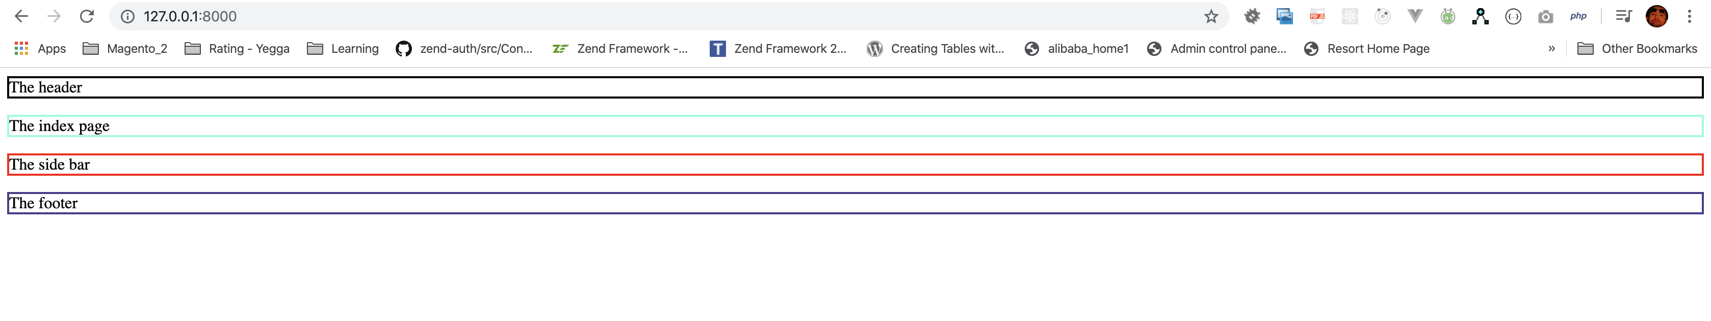
Views - Defining A Blade Layout for Frontend
2

Slide 12
Views - Defining A Blade Layout for Frontend
Apply the template files
Move css, vender folders into public/assets folder.
Replace the master layout, header, Sidebar, Footer and Index templates contents with the template html
Change the css, javascript and images with base url - URL::asset as follows
For CSS:
<link rel="stylesheet" href="{{ asset('assets/css/main-style.css') }}">
For JS:
<script type="text/javascript" src="{{ asset('assets/vendor/jquery/jquery.min.js') }}”></script>
For Links:
<a href="{{route('frontend.home')}}">Home</a>
2

Slide 13
Views - Defining A Blade Layout for Frontend
The Updated Routes
https://github.com/iyngaranedu/topup-blogs/blob/03-Views-with-template-css/routes/web.php
The Updated Master Layout
https://github.com/iyngaranedu/topup-blogs/blob/03-Views-with-template-css/resources/views/front-end/layouts/default.blade.php
The Updated Header
https://github.com/iyngaranedu/topup-blogs/blob/03-Views-with-template-css/resources/views/front-end/layouts/header.blade.php
The Updated Sidebar
https://github.com/iyngaranedu/topup-blogs/blob/03-Views-with-template-css/resources/views/front-end/layouts/sidebar.blade.php
The Updated Footer
https://github.com/iyngaranedu/topup-blogs/blob/03-Views-with-template-css/resources/views/front-end/layouts/footer.blade.php
The Updated Index Page
https://github.com/iyngaranedu/topup-blogs/blob/03-Views-with-template-css/resources/views/front-end/views/home/index.blade.php
2

Slide 14
Views - Defining A Blade Layout for Frontend
2

Slide 15
Views - Defining A Blade Layout for Backend
The Master Layout
https://github.com/iyngaranedu/topup-blogs/blob/04-Backend-Views-with-template-css/resources/views/back-end/layouts/default.blade.php
The Header
https://github.com/iyngaranedu/topup-blogs/blob/04-Backend-Views-with-template-css/resources/views/back-end/layouts/header.blade.php
The Sidebar
https://github.com/iyngaranedu/topup-blogs/blob/04-Backend-Views-with-template-css/resources/views/back-end/layouts/sidebar.blade.php
The Footer
https://github.com/iyngaranedu/topup-blogs/blob/04-Backend-Views-with-template-css/resources/views/back-end/layouts/footer.blade.php
The Dashboard Index Page
https://github.com/iyngaranedu/topup-blogs/blob/04-Backend-Views-with-template-css/resources/views/back-end/views/dashboard/index.blade.php
2

Slide 16
Laravel Controller
In MVC architecture, the Controller acts as a coordinator between the view and the model and also handles the users requests.
Defining Controllers
The following command will generate a controller at app/Http/Controllers/HelloController.php.
php artisan make:controller HelloController
https://github.com/iyngaranedu/topup-blogs/blob/05-Controllers-Frontend/app/Http/Controllers/HelloController.php
Next, you may register a route to the controller:
Route::get('/hello', ‘HelloController@hello’)->name('frontend.hello.test');
Refer the Laravel documentation for more details - https://laravel.com/docs/6.x/controllers
https://www.youtube.com/watch?v=98ChVWjI6KI&t=33s
2

Slide 17
Controller - Defining controllers for Frontend
The HomeController for home page: php artisan make:controller Frontend/HomeController
https://github.com/iyngaranedu/topup-blogs/blob/05-Controllers-Frontend/app/Http/Controllers/Frontend/HomeController.php
The CmsController for Cms pages (About Us, Contact Us): php artisan make:controller Frontend/CmsController
https://github.com/iyngaranedu/topup-blogs/blob/05-Controllers-Frontend/app/Http/Controllers/Frontend/CmsController.php
The BlogController for Blog pages: php artisan make:controller Frontend/BlogController
https://github.com/iyngaranedu/topup-blogs/blob/05-Controllers-Frontend/app/Http/Controllers/Frontend/BlogController.php
Modify the routes and map the controllers: https://github.com/iyngaranedu/topup-blogs/blob/05-Controllers-Frontend/routes/web.php
Look at the changes - https://github.com/iyngaranedu/topup-blogs/commit/18af43caa99a55f44653d216fb009bc3bea4903c
2

Slide 18
Controller - Defining controllers for Backend
The DashboardController: php artisan make:controller Backend/DashboardController
The CategoryController: php artisan make:controller Backend/CategoryController
The PostController: php artisan make:controller Backend/PostController
Look at the changes - https://github.com/iyngaranedu/topup-blogs/commit/9d8dcdc37a46b7ec6852ac29083e6cc89386da13
2

Slide 19
Database : Connecting to MySQL database
Once the database is created, you need to tell your laravel project the details about the database.
Laravel has a pretty simple way to do that, Open the .env file and update the credentials to access your MySQL database:
DB_CONNECTION=mysql
DB_HOST=127.0.0.1
DB_PORT=3306
DB_DATABASE=laravel
DB_USERNAME=root
DB_PASSWORD=
You need to enter the database name, the username and password.
At this point, you can run the migrate command to create your database and a bunch of SQL tables needed by Laravel:
php artisan migrate
2

Slide 20
Database: Migrations
Laravel provides a beautiful feature of database migration.
We can manage database versioning of application. we also can track who modified what? We can manage our database through server side code.
Generating Migrations
To create a migration, use the make:migration Artisan command:
php artisan make:migration create_category_table
php artisan make:migration create_category_table --create=tbl_categories
The new migration will be placed in your database/migrations directory.
Refer the Laravel documentation for more details -https://laravel.com/docs/5.8/migrations
https://www.youtube.com/watch?v=vh7E9JH7oSo
2

Slide 21
Database: Generating Migrations
Generate migration for Category table
php artisan make:migration create_category_table --create=tbl_categories
https://github.com/iyngaranedu/topup-blogs/blob/07-Database-Migrations/database/migrations/2020_02_15_152622_create_category_table.php
Generate migration for Tags table
php artisan make:migration create_tags_table --create=tbl_tags
https://github.com/iyngaranedu/topup-blogs/blob/07-Database-Migrations/database/migrations/2020_02_16_014339_create_tags_table.php
Generate migration for Posts table
php artisan make:migration create_posts_table --create=tbl_posts
https://github.com/iyngaranedu/topup-blogs/blob/07-Database-Migrations/database/migrations/2020_02_16_014836_create_posts_table.php
2

Slide 22
Database: Generating Migrations
Generate migration for Comments table
php artisan make:migration create_comments_table --create=tbl_comments
https://github.com/iyngaranedu/topup-blogs/blob/07-Database-Migrations/database/migrations/2020_02_16_015745_create_comments_table.php
Generate migration for tbl_blogs_tags (join table) table
php artisan make:migration create_blogs_tags_table --create=tbl_blogs_tags
https://github.com/iyngaranedu/topup-blogs/blob/07-Database-Migrations/database/migrations/2020_02_16_021000_create_blogs_tags_table.php
2

Slide 23
Database: Seeding
Laravel includes a simple method of seeding your database with test data using seed classes. All seed classes are stored in the database/seeds directory.
Writing Seeders
To generate a seeder, execute the make:seeder Artisan command.
php artisan make:seeder UsersTableSeeder
The run() method in UsersTableSeeder
public function run()
{
DB::table('users')->insert([
'name' => ‘Iyngaran',
'email' => 'iyngaran@dev.com',
'password' => bcrypt('iyn123!'),
]);
}
2

Slide 24
Database: Seeding
Call the UsersTableSeeder from DatabaseSeeder.
The run() method in DatabaseSeeder
public function run()
{
$this->call(UsersTableSeeder::class);
}
Running Seeders
Once you have written your seeder, you may need to regenerate Composer's autoloader using the dump-autoload command:
composer dump-autoload
Now you may use the db:seed Artisan command to seed your database.
php artisan db:seed
Now you may use the db:seed Artisan command to seed your database.
php artisan db:seed --class=UsersTableSeeder
Refer the Laravel documentation for more details - https://laravel.com/docs/6.x/seeding
https://www.youtube.com/watch?v=U5gxiPNcSZU
2

Slide 25
Models
In MVC architecture, The model is responsible for managing the data of the application. It receives user input from the controller.
It is the central component of the pattern. It is the application's dynamic data structure, independent of the user interface. It directly manages the data, logic and rules of the application.
2

Slide 26
Eloquent
The Eloquent ORM included with Laravel provides a beautiful, simple ActiveRecord implementation for working with your database. Each database table has a corresponding "Model" which is used to interact with that table. Models allow you to query for data in your tables, as well as insert new records into the table.
Defining Models
The easiest way to create a model instance is using the make:model Artisan command:
php artisan make:model Category
If you would like to generate a database migration when you generate the model, you may use the --migration or -m option:
php artisan make:model Category —migration / php artisan make:model Category —m
2

Slide 27
Eloquent Model Conventions
Let's look at an example Category model, which we will use to retrieve and store information from our categories database table:
The Category Model
namespace App;
use Illuminate\Database\Eloquent\Model;
class Category extends Model
{
//
}
2

Slide 28
Eloquent Model Conventions
You may specify a custom table by defining a table property on your model:
The Category Model
namespace App;
use Illuminate\Database\Eloquent\Model;
class Category extends Model
{
protected $table = 'tbl_categories';
}
Refer the Laravel documentation for more details - https://laravel.com/docs/5.8/eloquent
https://laravel.com/docs/5.8/eloquent-relationships
2

Slide 29
Creating Eloquent Models
You may specify a custom table by defining a table property on your model:
The Category Model
namespace App;
use Illuminate\Database\Eloquent\Model;
class Category extends Model
{
protected $table = 'tbl_categories';
}
Refer the Laravel documentation for more details - https://laravel.com/docs/5.8/eloquent
2

Slide 30
Database: Seeding Using Model Factories
Call the UsersTableSeeder from DatabaseSeeder.
The run() method in DatabaseSeeder
public function run()
{
$this->call(UsersTableSeeder::class);
}
Running Seeders
Once you have written your seeder, you may need to regenerate Composer's autoloader using the dump-autoload command:
composer dump-autoload
Now you may use the db:seed Artisan command to seed your database.
php artisan db:seed
Now you may use the db:seed Artisan command to seed your database.
php artisan db:seed --class=UsersTableSeeder
Refer the Laravel documentation for more details - https://laravel.com/docs/6.x/seeding
https://www.youtube.com/watch?v=U5gxiPNcSZU
2

Slide 31
Useful Links
https://laracasts.com/series/laravel-6-from-scratch/episodes/1
2

Slide 32
Any questions ?

